Slide 1
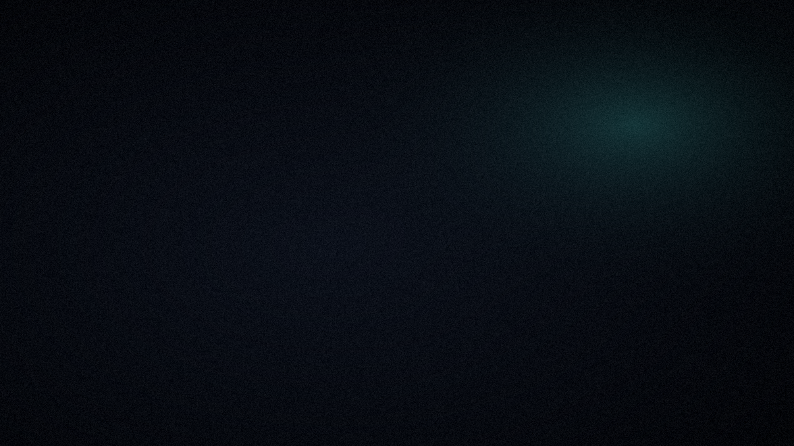
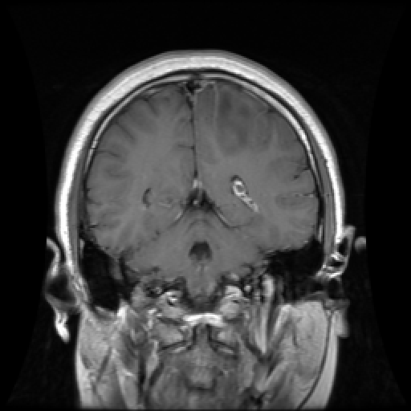
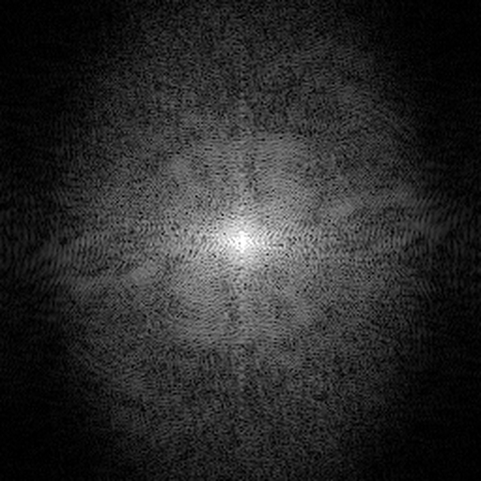
CSE 220 · SIGNALS AND SYSTEMS · TEAM NETWORK_ER_BAIRE
MRI k-Space
Reconstruction Simulator
A scanner never takes a photograph. This is what happens when you measure less of its Fourier transform — and how much of it you can win back.
Part One · Afif Siddique · 2305123
K-SPACE · log(1+|K|)
Part Two · Shafnan Wasif · 2305126
Dept. of CSE, BUET · 2026 · github.com/Rohan15035/Signal_Project
Notes:
Open on the picture: the same brain slice in two domains. Left is what a radiologist sees; right is what the scanner actually measures. The whole talk is about the relationship between those two pictures.

Slide 2
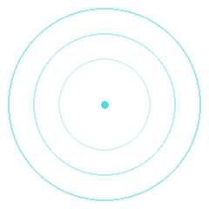
THE PREMISE
AFIF SIDDIQUE · 2305123
A scanner never photographs you —
it measures a Fourier transform, point by point.
FFT
IFFT
IMAGE DOMAIN ρ(x, y)
FREQUENCY DOMAIN S(kx, ky)
S(kx, ky) = ∬ ρ(x, y) · exp(−j2π(kx·x + ky·y)) dx dy
Magnetic field gradients map time to spatial frequency. The image on the radiologist's screen is recovered afterwards by an inverse FFT — a reconstruction, not a capture.
MRI k-SPACE RECONSTRUCTION SIMULATOR · CSE 220
02 / 18
Notes:
Key point: the raw measurement is a frequency-domain signal. The centre of k-space is bright (low frequencies) and falls off quickly toward the edges. Everything later is an operation on the right-hand picture, judged on the left.

Slide 3
THE PROBLEM
AFIF SIDDIQUE · 2305123
MRI is slow, and time is paid in samples.
1 row / TR
25% → 4×
Minutes
A Cartesian scan fills one line of k-space per pulse repetition. Lines are time.
Acquire a quarter of k-space and the scan is four times faster. The saving is real.
per sequence — patients must lie still; young children are often sedated.
If we acquire only a fraction of k-space, how bad is the image — and does it depend on which fraction we skip?
It depends enormously — the same 12.5% of k-space gives very different images depending on the sampling pattern.
MRI k-SPACE RECONSTRUCTION SIMULATOR · CSE 220
03 / 18
Notes:
Motivation: scan time is proportional to the number of k-space samples. So the engineering question is a signals question — how much of the Fourier transform can we skip, and where? State the research question slowly.

Slide 4
METHOD
AFIF SIDDIQUE · 2305123
One pipeline turns a clinical image into a verdict.
01
02
03
04
05
06
07
Image
Phase
FFT
Mask
Noise
Invert
Score
ρ(x,y) in [0,1]
breaks symmetry
shifted, DC centred
Cartesian / radial / random
complex Gaussian, target SNR
zero-fill or FISTA
PSNR & SSIM vs truth
Why start from an image?
Raw scanner k-space is rarely public. We forward-FFT real clinical slices; from that point on, masking, noise and reconstruction are exactly what a scanner faces. The inverse FFT assumes every unmeasured sample is zero — that wrong guess is the artifact.
MRI k-SPACE RECONSTRUCTION SIMULATOR · CSE 220
04 / 18
Notes:
Walk the chain left to right, one click per stage. Step 2 matters: source images are magnitude-only, so a smooth phase map breaks Hermitian symmetry, as real physics does. Land the key sentence on the dark card: the wrong zero-fill guess is the artifact.

Slide 5
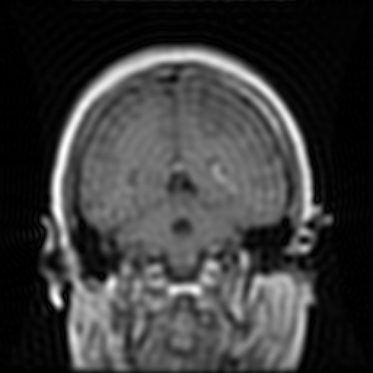
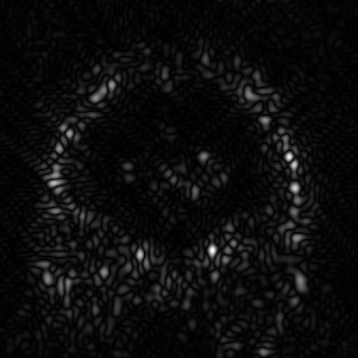
WHAT K-SPACE HOLDS
AFIF SIDDIQUE · 2305123
The centre carries contrast. The edges carry detail.
92.6%
of k-space energy lies inside the central 10% radius — about 1% of the samples. Mean of 40 clinical scans; range 73.6–98.9%.
73 dB
CENTRE ONLY · low-pass
EDGES ONLY · high-pass
Mean 0.231 vs truth 0.229.
Blur plus Gibbs ringing.
Mean 0.0002 — the DC term
is gone. Contrast-stretched.
mean peak-to-median dynamic range (62–85 dB) — why k-space is always shown as log(1+|K|).
Both images use the same 5% sample budget · brain-glioma-778
MRI k-SPACE RECONSTRUCTION SIMULATOR · CSE 220
05 / 18
Notes:
A controlled experiment: same number of samples, only the location changes. Centre-only keeps average brightness because it keeps the DC term; its hard rim causes Gibbs ringing. Edges-only is nearly black until stretched — then it's an edge map. This is why every realistic mask protects the centre.

Slide 6
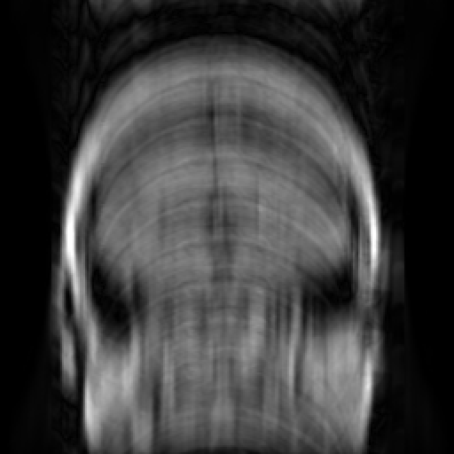
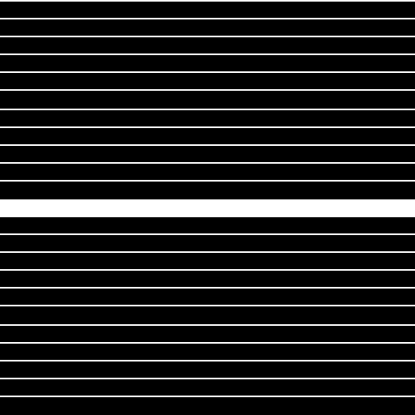

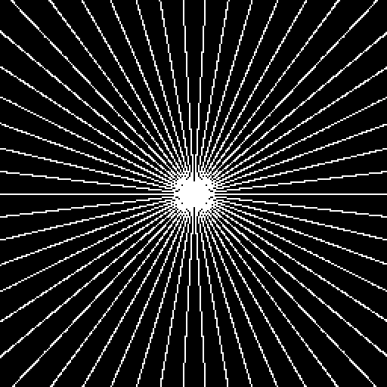

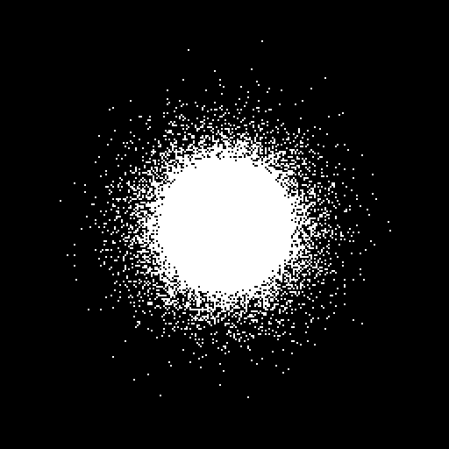
SAMPLING STRATEGIES · 12.5% OF K-SPACE, 8× FASTER
AFIF SIDDIQUE · 2305123
Same budget, three different artifacts.
CARTESIAN
RADIAL
VARIABLE DENSITY
20.37 dB · SSIM 0.604
22.84 dB · SSIM 0.489
30.37 dB · SSIM 0.807
Coherent ghosts — shifted copies that look like real anatomy. The hardest to remove.
Streaks that radiate from bright edges, because spoke gaps widen with radius.
Incoherent grain instead of structure — exactly what compressed sensing needs.
MRI k-SPACE RECONSTRUCTION SIMULATOR · CSE 220
06 / 18
Notes:
Click through the three, same number of samples in all — what differs is the shape of the error. Cartesian ghosts are dangerous because a radiologist could mistake them for structure. Radial and random are incoherent — easier to see through, and later, easier to remove.

Slide 7

STAGE 2 · NOISE.PY
AFIF SIDDIQUE · 2305123
Scanner noise belongs in k-space, not the image.
32.01 dB
PSNR at 20 dB k-space SNR, full sampling · SSIM 0.716 — the app reads the SNR back to verify it.
Complex. The receiver has independent I and Q channels.
White in k-space. The same σ swamps tiny outer samples but barely touches DC — detail fades before contrast.
Mask first, then noise. A 25% scan admits about 25% of the noise energy, as SNR ∝ √N predicts.
20 dB k-space SNR, full sampling
Rician background haze, not black
σ = √( mean|K|² / (2 · 10^(SNR/10)) )
MRI k-SPACE RECONSTRUCTION SIMULATOR · CSE 220
07 / 18
Notes:
Order matters: mask first, then noise, models a scanner that only ever measures the samples it takes. Rough guide: 40 dB is a clean clinical scan, 20 dB visibly grainy, 10 dB bad. The app's tab 3 separates noise from undersampling as independent effects.

Slide 8


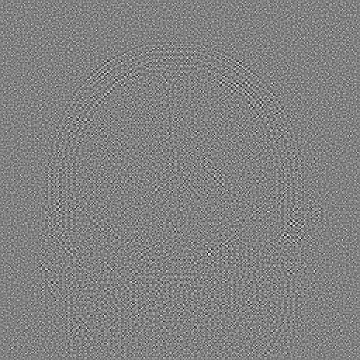
STAGE 2 · DENOISE.PY
AFIF SIDDIQUE · 2305123
Taking the noise back out — keep the edges, drop the grain.
soft(w, T) = sign(w) · max(|w| − T, 0) T = σ² / σ_signal per band
In a wavelet basis, anatomy is a few large coefficients and white noise is many small ones. Soft thresholding (BayesShrink, db4, 3 levels) removes the small ones. The noise level is estimated from the image alone: σ̂ = 0.0208 vs 0.0232 true.
NOISY · 20 dB
WAVELET DENOISED
REMOVED
Input · 32.01 dB · 0.716
Output · 33.77 dB · 0.779
Noisy − denoised · grain + faint edges
Not free: at 10 dB SSIM rises 0.40 → 0.58, but on a knee at 30 dB fine texture is mistaken for noise and PSNR falls 39.3 → 37.2 dB.
MRI k-SPACE RECONSTRUCTION SIMULATOR · CSE 220
08 / 18
Notes:
Noise went in on the previous slide; this takes it back out. In a wavelet basis anatomy is a few large coefficients and white noise is many small ones, so soft thresholding removes the grain and keeps the edges. The denoiser is not told the noise level: it estimates it from the finest diagonal wavelet band (0.0208 here vs 0.0232 true). Point at the third card: the residual should be pure grain; the faint skull outline is real edge detail that was removed too. Live: tab 3, drag the strength slider to 2 and watch anatomy appear in the residual.

Slide 9

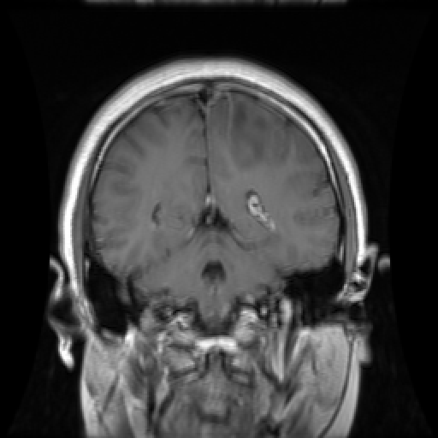

STAGE 2 · MOTION.PY
AFIF SIDDIQUE · 2305123
Patient motion, through the Fourier shift theorem.
f(x − a) ⟷ F(k) · e^(−j2πka/N)
A uniform shift only stamps a phase ramp — harmless. But a Cartesian scan fills one row per TR, so row index is time. Move mid-scan and rows carry different ramps, describing no single object.
SUDDEN JERK
SLOW DRIFT
BREATHING
Discrete ghost · 22.75 dB · 0.793
Blur · 21.07 dB · 0.754
Ghost train · 21.37 dB · 0.646
For scale: a 5 px jerk on a fully sampled scan scores below 8× variable-density undersampling (30.37 dB) — motion is often the bigger threat.
MRI k-SPACE RECONSTRUCTION SIMULATOR · CSE 220
09 / 18
Notes:
Jerk: rows before/after are each consistent, describing two sharp objects — one ghost. Drift: every row disagrees slightly with its neighbours, so the inconsistency spreads as blur. Breathing: a sinusoid is a pair of complex exponentials, so the image is convolved with two deltas — a regular ghost train.

Slide 10


STAGE 2 · MOTION_CORRECTION.PY
AFIF SIDDIQUE · 2305123
Motion destroys nothing — it only rotates phase.
corrected row = corrupted row · e^(+j2π·ky·dy/N) |ramp| = 1 → exact undo
The whole problem is knowing dy for each row. The oracle uses the true motion, as a navigator echo or camera would. Autofocus sees only the corrupted scan: it tries candidate motions and keeps the sharpest image (lowest gradient entropy).
WITH MOTION
ORACLE · TRUE MOTION
AUTOFOCUS · ESTIMATED
Breathing 5 px × 4 · 21.37 dB · 0.646
Exact · 324.9 dB · 1.000
Found 5.0 px × 4.0 cycles · exact
Across 42 tests with noise, undersampling and radial scans, every case improved; 35 came within 0.005 SSIM of the oracle. Weakest: radial drift.
MRI k-SPACE RECONSTRUCTION SIMULATOR · CSE 220
10 / 18
Notes:
Key sentence: motion only rotated the phase of each row, and the ramp has magnitude 1, so multiplying by the conjugate ramp undoes it exactly. The hard part is knowing the motion. Oracle = the true displacements, what a navigator echo or optical tracker provides. Autofocus = no extra information: try candidate motions of the known type and keep the sharpest result, scored by gradient entropy. Here it found 5.0 px x 4.0 cycles, exactly the truth. Be honest about limits: the motion type must be known, radial drift is ~1-3 px off, and very large fast breathing can be missed. Live: tab 6, press Run autofocus.

Slide 11
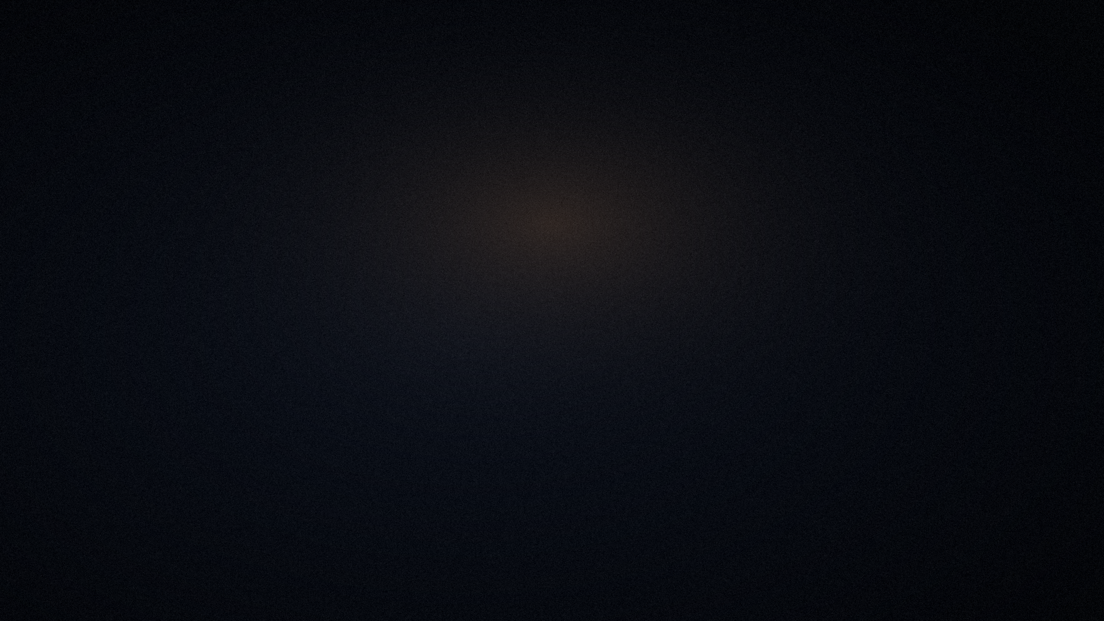
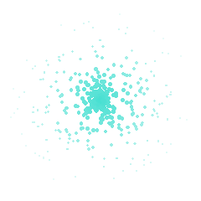
PART TWO
Compressed sensing, reduced FOV
& the live application.
Presented by
Shafnan Wasif · 2305126
Part One was presented by Afif Siddique · 2305123
MRI k-SPACE RECONSTRUCTION SIMULATOR · CSE 220
11 / 18
Notes:
Hand off cleanly: one sentence on what Part One covered (the physics, the sampling trade-off, noise and denoising, motion and its correction), then set up what's coming — recovering signal with compressed sensing, scanning smarter with reduced FOV, and the live app.

Slide 12


COMPRESSED SENSING VS. ZERO-FILL
SHAFNAN WASIF · 2305126
A smarter guess recovers +2.00 dB from the same measurements.
+2.00 dB
+0.118 SSIM
16× · 6.25% sampled
ZERO-FILL
FISTA (CS)
26.10 dB · SSIM 0.643
28.10 dB · SSIM 0.761
min ‖M·F·x − y‖² + λ‖W·x‖₁ M mask · F FFT · y measured k-space · W Daubechies-4 wavelet, FISTA · 80 iterations · ≈1.5 s
Where CS loses: above ~15% sampling, zero-fill is already near-perfect and the prior costs PSNR. The app says so.
MRI k-SPACE RECONSTRUCTION SIMULATOR · CSE 220
12 / 18
Notes:
The only thing that changed between the two images is the answer to 'what was not measured?'. The gain grows as undersampling becomes more aggressive. Live: tab 4, push the ratio to 16× and show the per-iteration PSNR curve.

Slide 13
SWEEP · SHEPP–LOGAN PHANTOM, 256×256, NO NOISE
SHAFNAN WASIF · 2305126
Quality falls fast — but not equally.
Round-trip check: every strategy scores 321.7 dB at 100% sampling — the correctness baseline before any of this.
50% · 2×
25% · 4×
12.5% · 8×
Cartesian
26.81 · 0.683
20.54 · 0.549
17.43 · 0.535
Radial
29.64 · 0.476
23.29 · 0.312
19.65 · 0.276
Variable density
31.58 · 0.823
28.86 · 0.722
25.81 · 0.478
Random wins on PSNR
No single ranking
Variable density leads at every ratio, and on SSIM at 2× and 4×.
At 8× on the phantom, Cartesian keeps the higher SSIM (0.535 vs 0.478) — one metric alone would hide this.
Cells: PSNR (dB) · SSIM · source: outputs/metrics.csv from python main.py · live: tab 5, Sweep
MRI k-SPACE RECONSTRUCTION SIMULATOR · CSE 220
13 / 18
Notes:
The 100% column is omitted because every strategy gives 321.7 dB there — say it out loud as the correctness check. Random sampling beats structured sampling on PSNR even before compressed sensing enters the picture. Be precise about the 8× SSIM exception on the phantom: it's a reminder that one metric alone can mislead — exactly why the next slide checks a specific failure mode rather than trusting a single ranking.

Slide 14
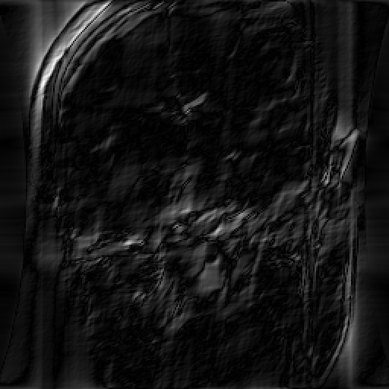
REDUCED FOV, SETUP · ROI.PY
SHAFNAN WASIF · 2305126
A corner of k-space, deleted — but the error is everywhere.
THE WRONG INSTINCT
If the target sits in one corner of the image, keep the matching corner of k-space and throw the rest away.
MEAN |ERROR| PER IMAGE QUADRANT
0.039
0.022
0.027
0.033
Nearly uniform — deleting one quadrant does not blank the matching quadrant of the image.
If k-space were local, one quadrant would carry nearly all the error and the rest close to zero. It doesn't work that way.
ERROR MAP AFTER DELETING THE TOP-LEFT K-SPACE QUADRANT
Every sample carries information about the whole object — position lives in phase, not location. So the right knob isn't which region of k-space you keep — it's how finely you sample. Next: reduced FOV.
MRI k-SPACE RECONSTRUCTION SIMULATOR · CSE 220
14 / 18
Notes:
The intuitive but wrong answer: if k-space were local, deleting the corner 'aimed at' the target should blank that part of the image and leave the rest untouched. It doesn't — mean error is similar in all four image quadrants after deleting one k-space quadrant. Position lives in phase, not location. That's why the next slide's answer is sample spacing, not corner-cropping. Live: tab 7, quadrant deletion, right before reduced FOV.

Slide 15
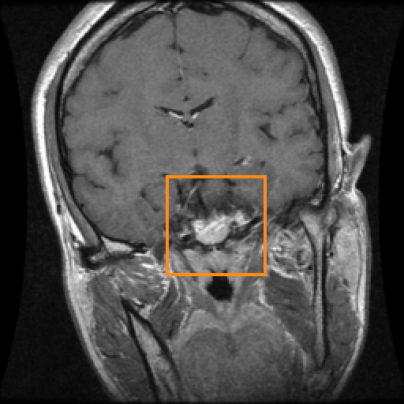
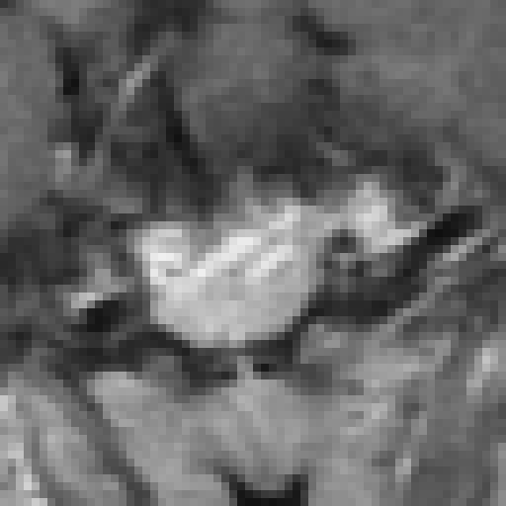
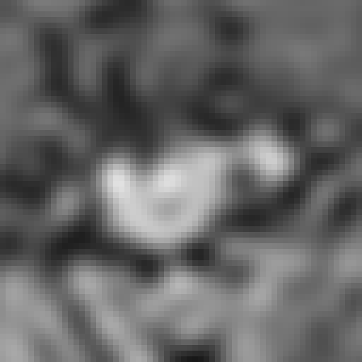
REDUCED FIELD OF VIEW · ROI.PY
SHAFNAN WASIF · 2305126
Scan only the region that matters — and get it exact.
330.8 dB · SSIM 1.000
Reduced FOV
Excite the box, decimate the grid — a complete, critically sampled measurement. Exact.
−12.9 dB
No RF suppression
Same grid, no excitation — 15 other pieces of the head fold onto the ROI. The error exceeds the signal.
TARGET: PITUITARY TUMOUR
R = 4 → 6.25% of k-space, 16× faster
Sample spacing Δk sets FOV (=1/Δk); extent k_max sets resolution (Δx=1/2k_max). Low-pass shrinks k_max — the wrong knob for this job.
MRI k-SPACE RECONSTRUCTION SIMULATOR · CSE 220
15 / 18
Notes:
The clinical question: we only care about the pituitary — can we scan just that? The wrong answer is to keep the matching corner of k-space (position lives in phase, not location). The right knob is sample spacing, which sets FOV, not extent, which sets resolution.

Slide 16
ARCHITECTURE
SHAFNAN WASIF · 2305126
A 10,000-line simulator: one library, one dataset, one live app.
1
2
3
4
LAYER 1 · LIBRARY
LAYER 2 · DATA
LAYER 3 · INTERFACE
BATCH · CLI
mri_sim/
kspace_store/
app/
main.py
Pure-NumPy simulator — kspace, noise, denoise, cs, motion, motion_correction, roi, metrics, visualize.
40 curated clinical samples as centred k-space, ground truth, phase and tumour mask, with full provenance.
Streamlit app, 8 tabs, shared sidebar: subject, strategy, ratio, SNR, seed. Heavy steps are cached.
Runs the full sweep of strategies and ratios; writes figures and metrics.csv to outputs/.
Invariant: every k-space array is fftshift-centred, DC at [N/2, N/2]. Inversion uses ifftshift, which differs from fftshift for odd sizes.
MRI k-SPACE RECONSTRUCTION SIMULATOR · CSE 220
16 / 18
Notes:
Roughly 10,000 lines of commented Python, including the compressed-sensing lab page and the denoising and motion-correction modules. Stack: NumPy, SciPy, scikit-image, PyWavelets, Matplotlib, Streamlit, pandas. The centring invariant is what lets every mask reason simply about distance from the middle.

Slide 17
TRY IT — 8 TABS, ONE SHARED SIDEBAR
SHAFNAN WASIF · 2305126
Everything on this deck, you can drive live.
1
2
3
4
Acquire
Centre vs Edges
Noise
Compressed Sensing
Drag the ratio 100%→5%; switch strategy at a fixed ratio.
Noise vs undersampling, SNR read back; wavelet denoiser + residual.
Low-pass vs high-pass on one budget; compare mean brightness.
Push to 16×; FISTA vs zero-fill with the convergence curve.
5
6
7
8
Sweep
Motion
Reduced FOV
Sample
PSNR/SSIM vs sampling for every strategy; CSV download.
Jerk, drift, breathing; oracle and autofocus correction.
Delete a k-space quadrant, then excite the ROI and decimate.
Provenance, acquisition metadata, expert tumour mask.
streamlit run app/streamlit_app.py → localhost:8501
MRI k-SPACE RECONSTRUCTION SIMULATOR · CSE 220
17 / 18
Notes:
Suggested running order if time is short: tab 1 (ratio slider, switch strategies at 12.5%), tab 3 (denoise strength slider, watch the residual), tab 4 (16×), tab 6 (sudden jerk, then Run autofocus), tab 7 (quadrant deletion, then reduced FOV). Tabs 2 and 5 are the ones already walked through as full slides — Centre vs Edges and Sweep. Start the app before the talk so the cache is warm; press Run autofocus once beforehand so it answers instantly.

Slide 18
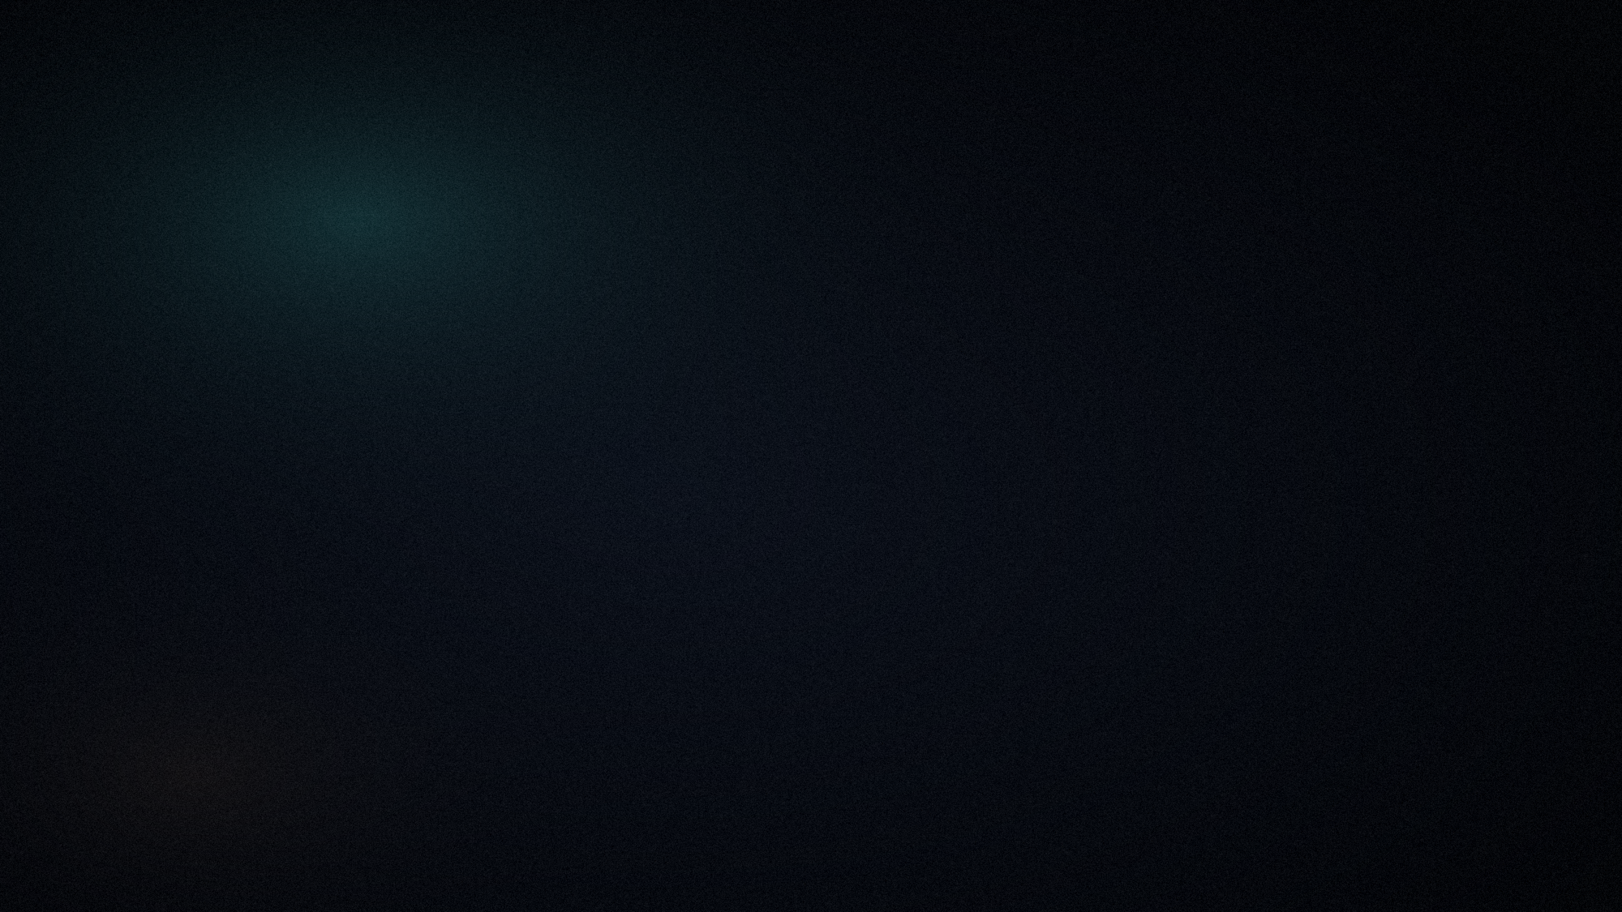
CONCLUSION
Which part of k-space you skip matters
as much as how much you skip.
92.6%
+2.00 dB
Exact
Protect the centre.
Guess better.
Respect the physics.
That much energy lives there — random sampling beats regular skipping.
Compressed sensing recovers it at 16× from the exact same measurements.
Reduced FOV is exact; without RF suppression, it collapses.
Thank you. Questions?
Part One — Afif Siddique · 2305123
Part Two — Shafnan Wasif · 2305126
github.com/Rohan15035/Signal_Project
CSE 220 · Signals and Systems · 2026
Notes:
Close on the one-sentence answer to the research question, then the three takeaways. Leave this slide up during questions.

